Slide 1
LAG TIME
EUR
aegis4048.github.io

Slide 2
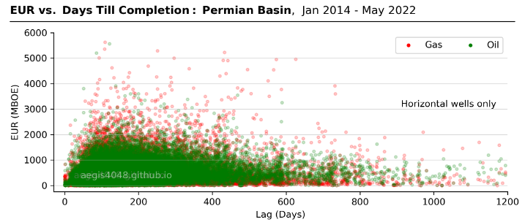

Slide 3
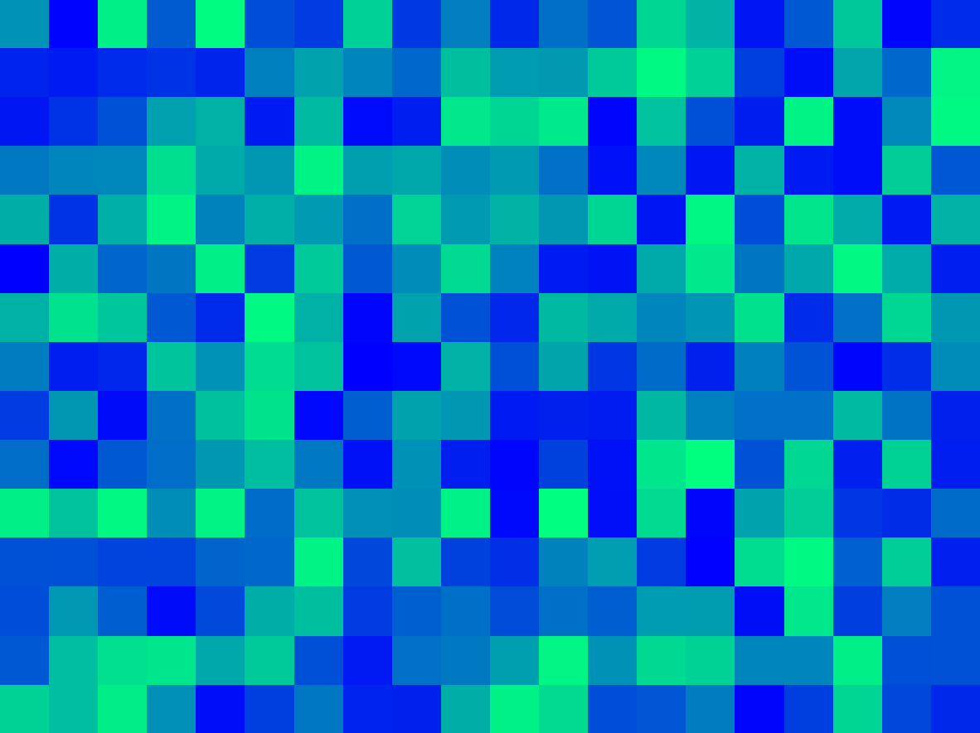
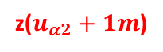
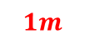
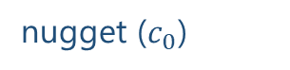
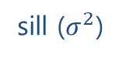
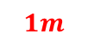
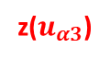
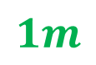
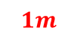
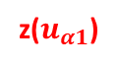
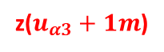
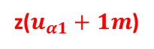

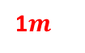
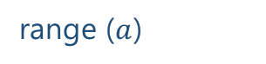

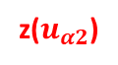
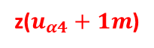
$$1m$$
variance ($γ$)
z($u_{α1}$)
z($u_{α1}+1m$)
sill ($σ^{2}$)
$$1m$$
$$1m$$
1$m$
nugget ($c_{0}$)
z($u_{α4}$)
z($u_{α4}+1m$)
z($u_{α2}$)
z($u_{α2}+1m$)
$$1m$$
range ($a$)
z($u_{α3}$)
z($u_{α3}+1m$)
lag distance (h)

Slide 4
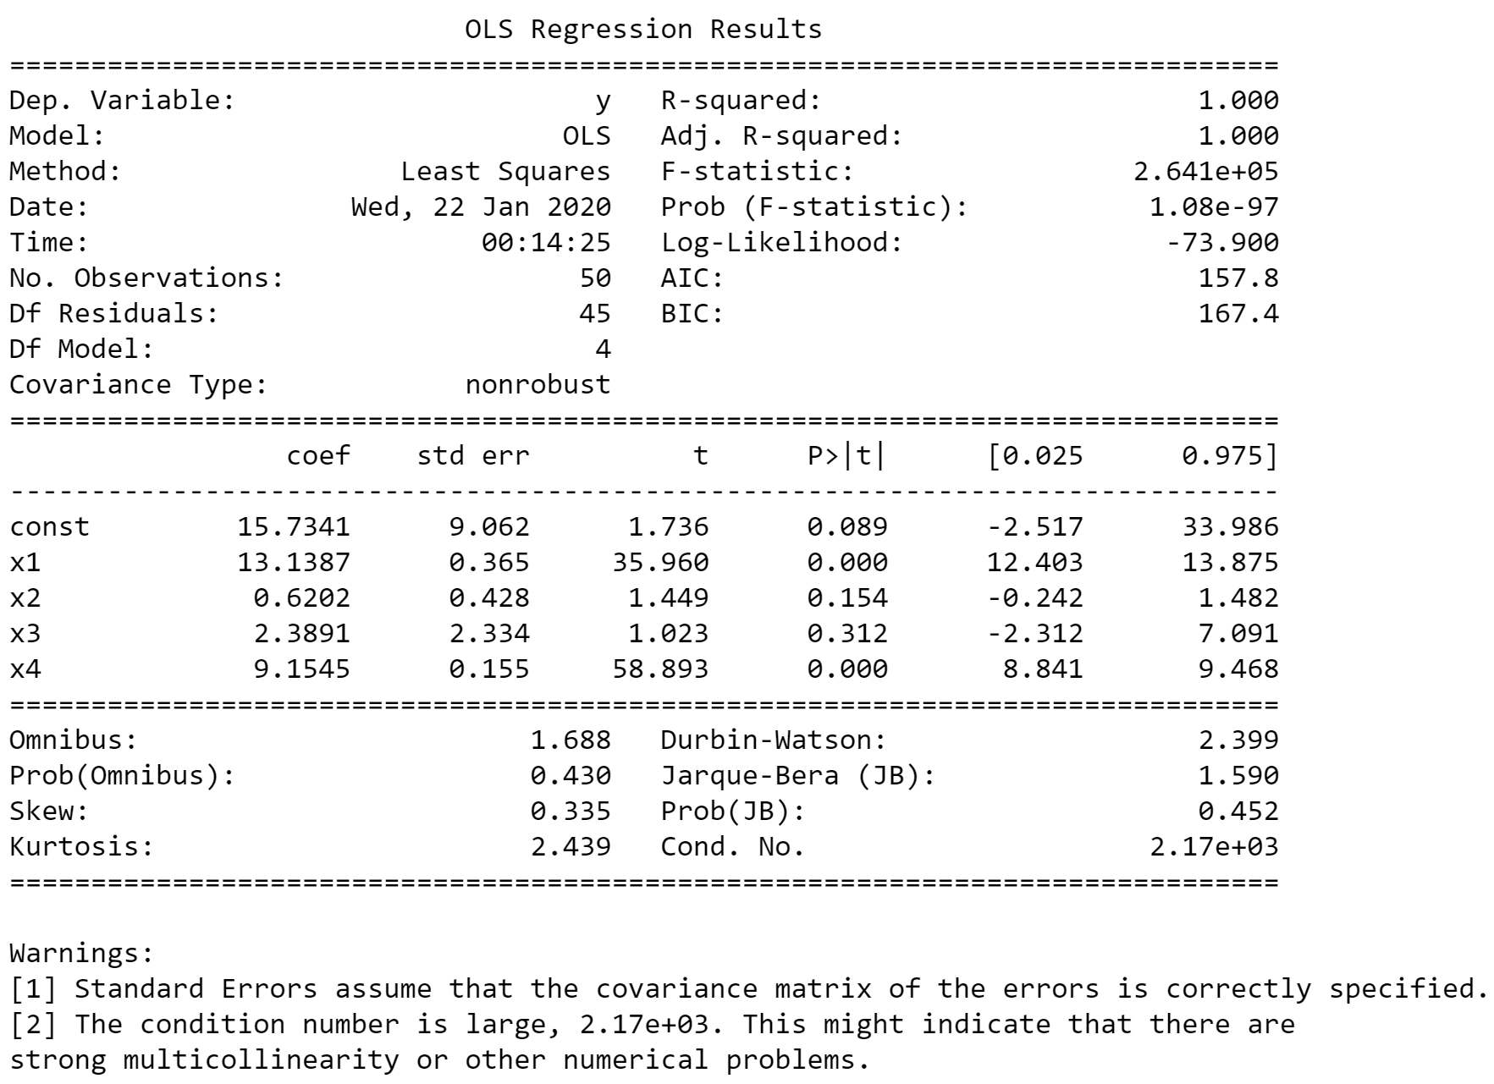
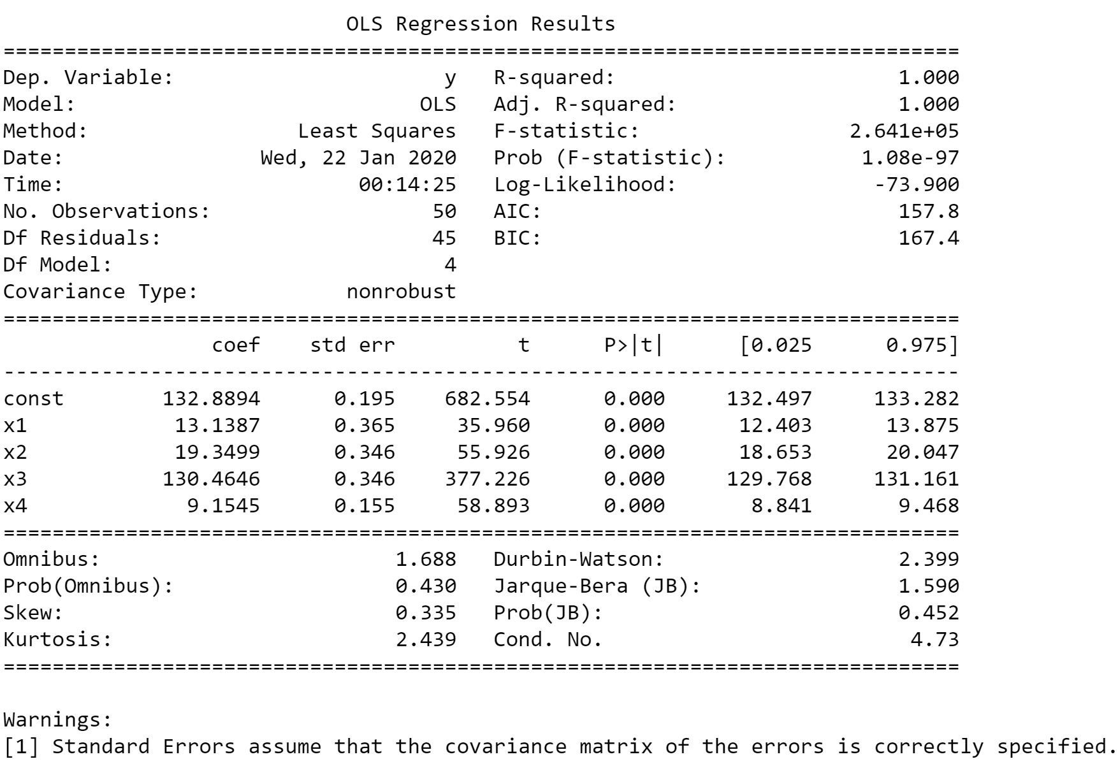
Original
Mean-centered

Slide 5
Original
Mean-centered

Slide 6
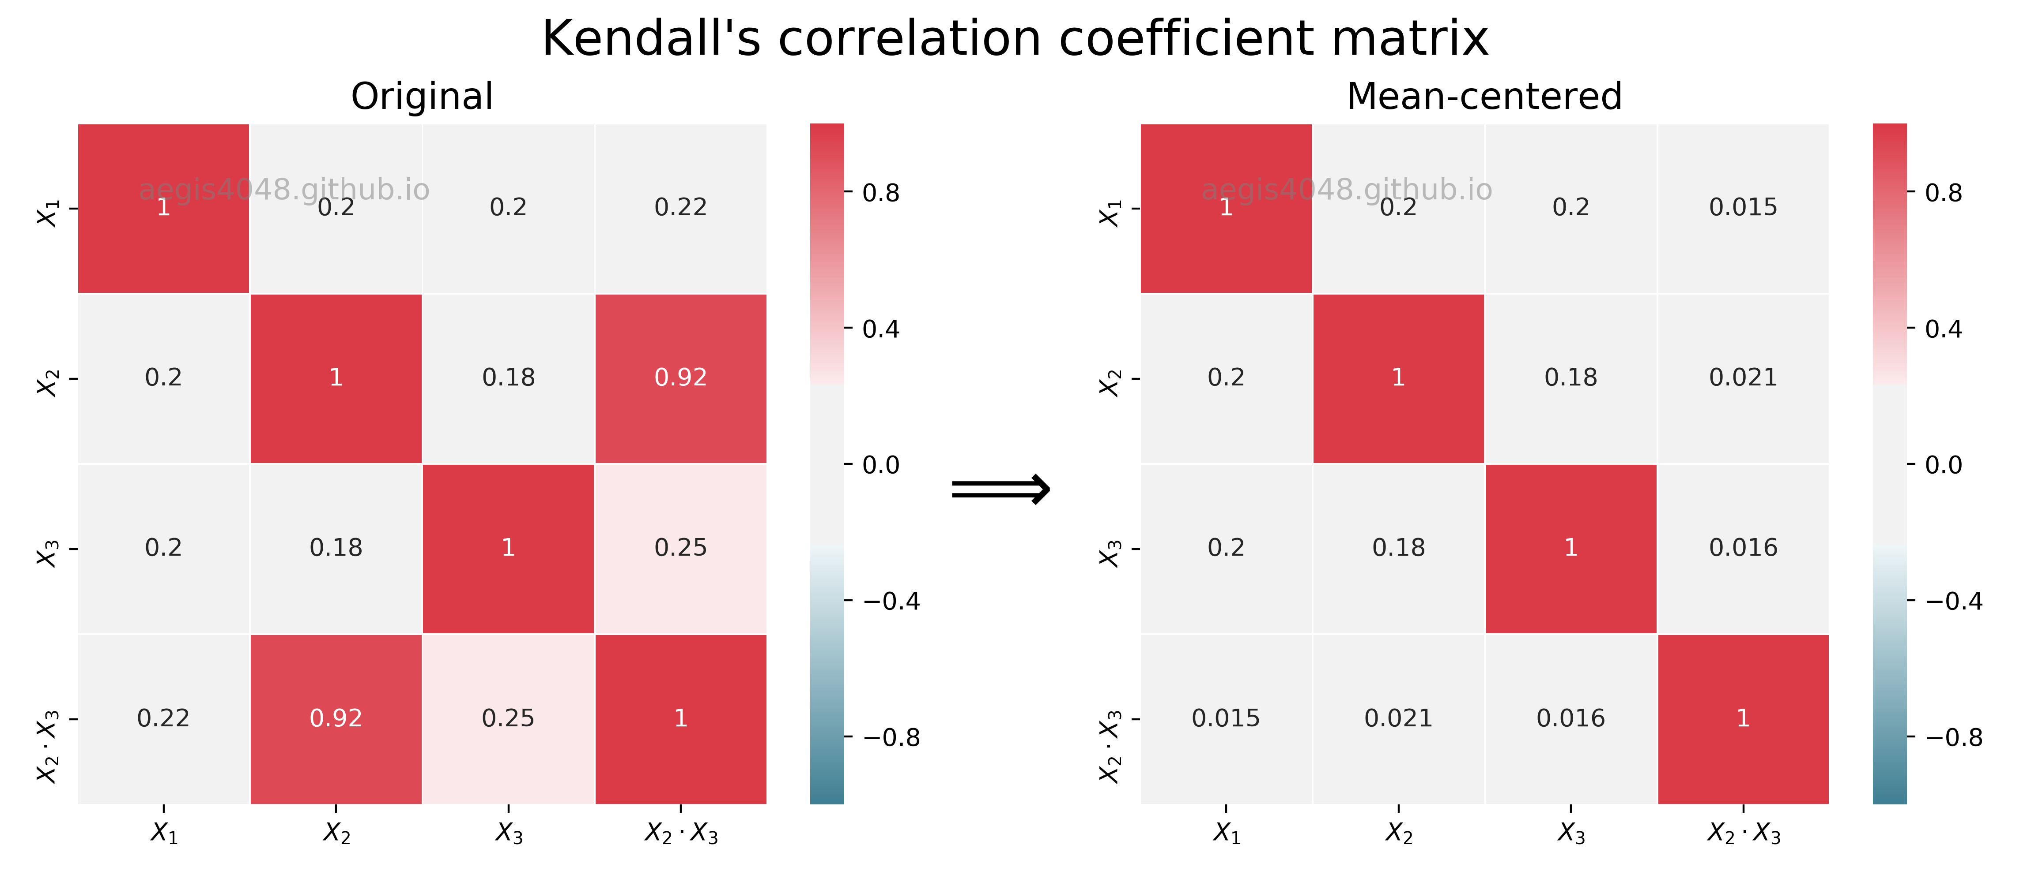
Unaffected
Reduced

Slide 7
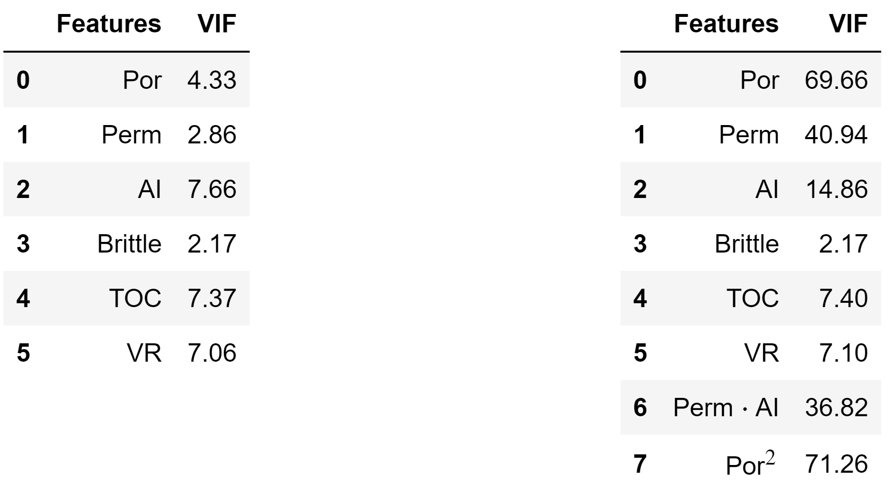
Original data
Interaction terms
VS
aegis4048.github.io
aegis4048.github.io

Slide 8
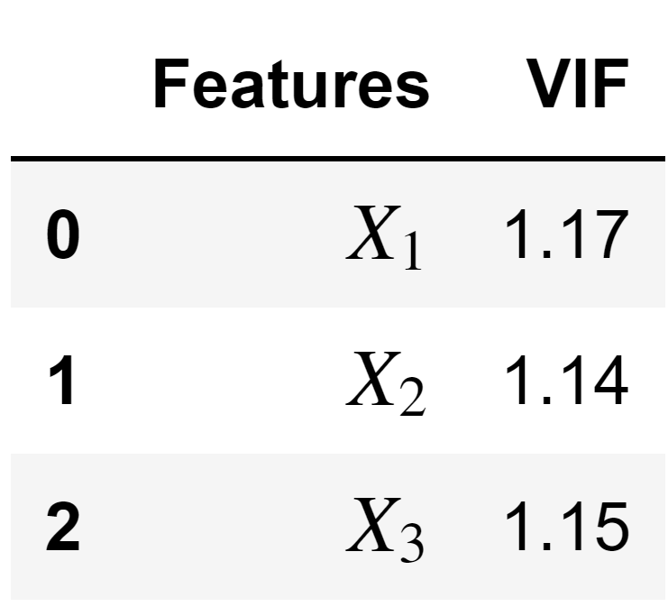
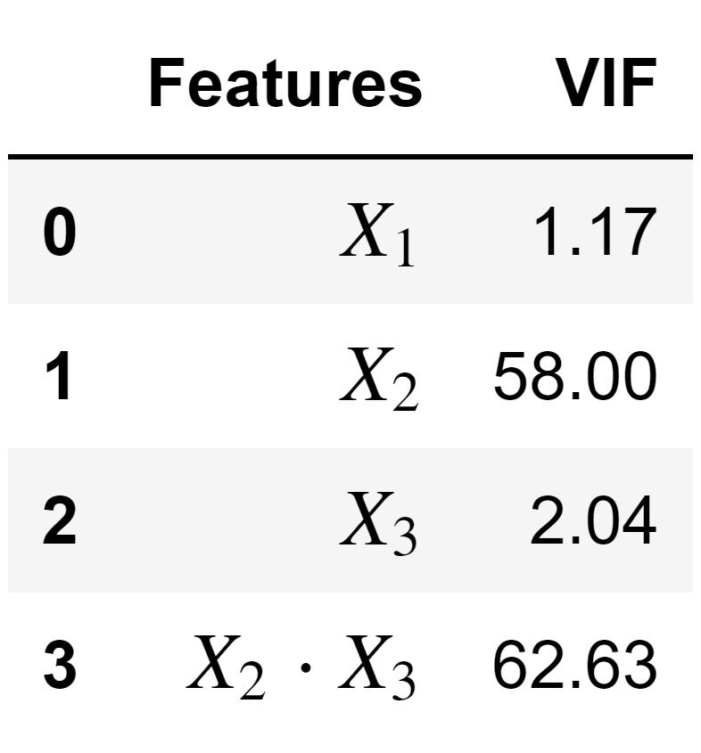
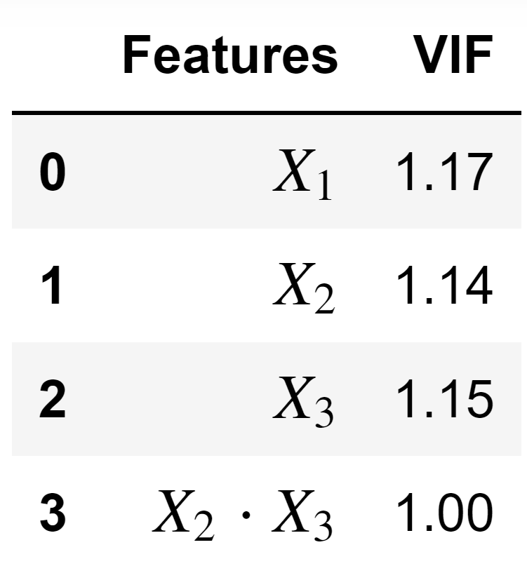
Original
Interaction
Mean-centered
aegis4048.github.io
aegis4048.github.io
aegis4048.github.io

Slide 9
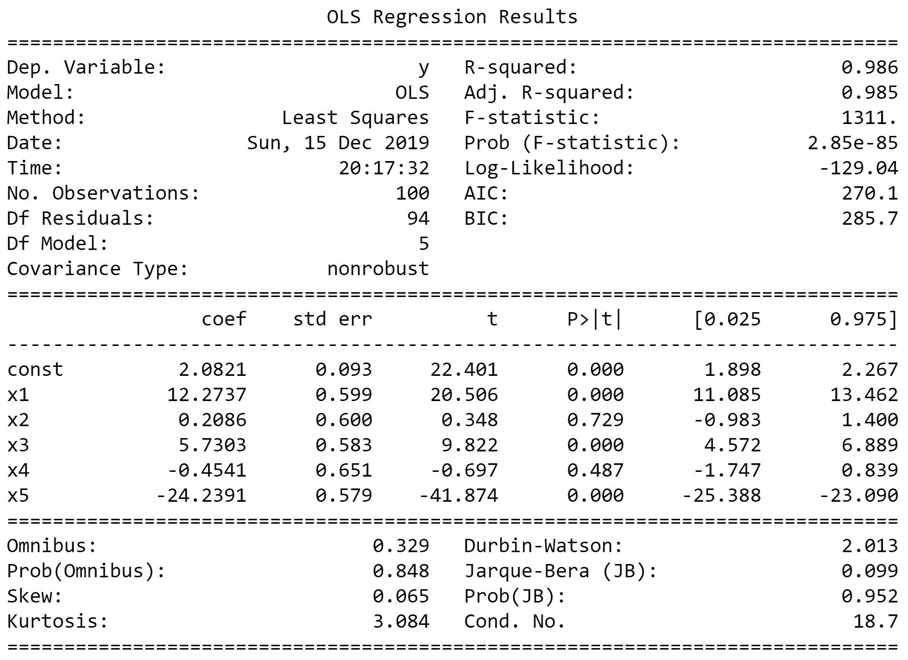
Wrong, due to overestimated std err
aegis4048.github.io

Slide 10
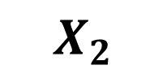
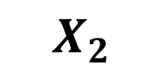
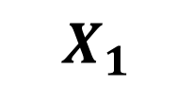
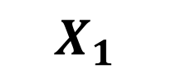
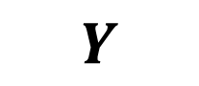
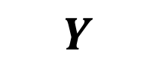
$$X_{1}$$
$$Y$$
$$X_{2}$$
$$X_{2}$$
$$X_{1}$$
$$Y$$
aegis4048.github.io
aegis4048.github.io
A. No Multicollinearity
B. Direct & High Multicollinearity

Slide 11
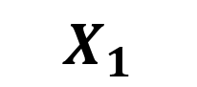
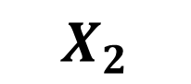
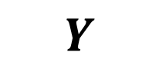
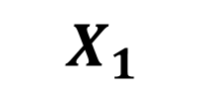
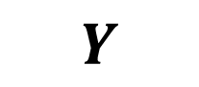
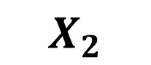
$$X_{1}$$
$$X_{2}$$
$$X_{1}$$
$$Y$$
$$X_{2}$$
aegis4048.github.io
aegis4048.github.io
$$Y$$
C. Indirect & Low Multicollinearity
D. Direct & Low Multicollinearity

Slide 12
Feature of Interest
Collinear Feature
Outcome
Temperature
Positive
Bacteria A
Negative
Bacteria A
aegis4048.github.io
Positive
Toxic Chem.
???
Bacteria B
???
Bacteria A
aegis4048.github.io
aegis4048.github.io
Negative
Bacteria B
Positive
Temperature
Positive
Bacteria A
Negative
aegis4048.github.io

Slide 13
Feature of Interest
Outcome
Temperature
Positive
Bacteria A
Toxic Chem.
Negative
aegis4048.github.io
Bacteria A

Slide 14
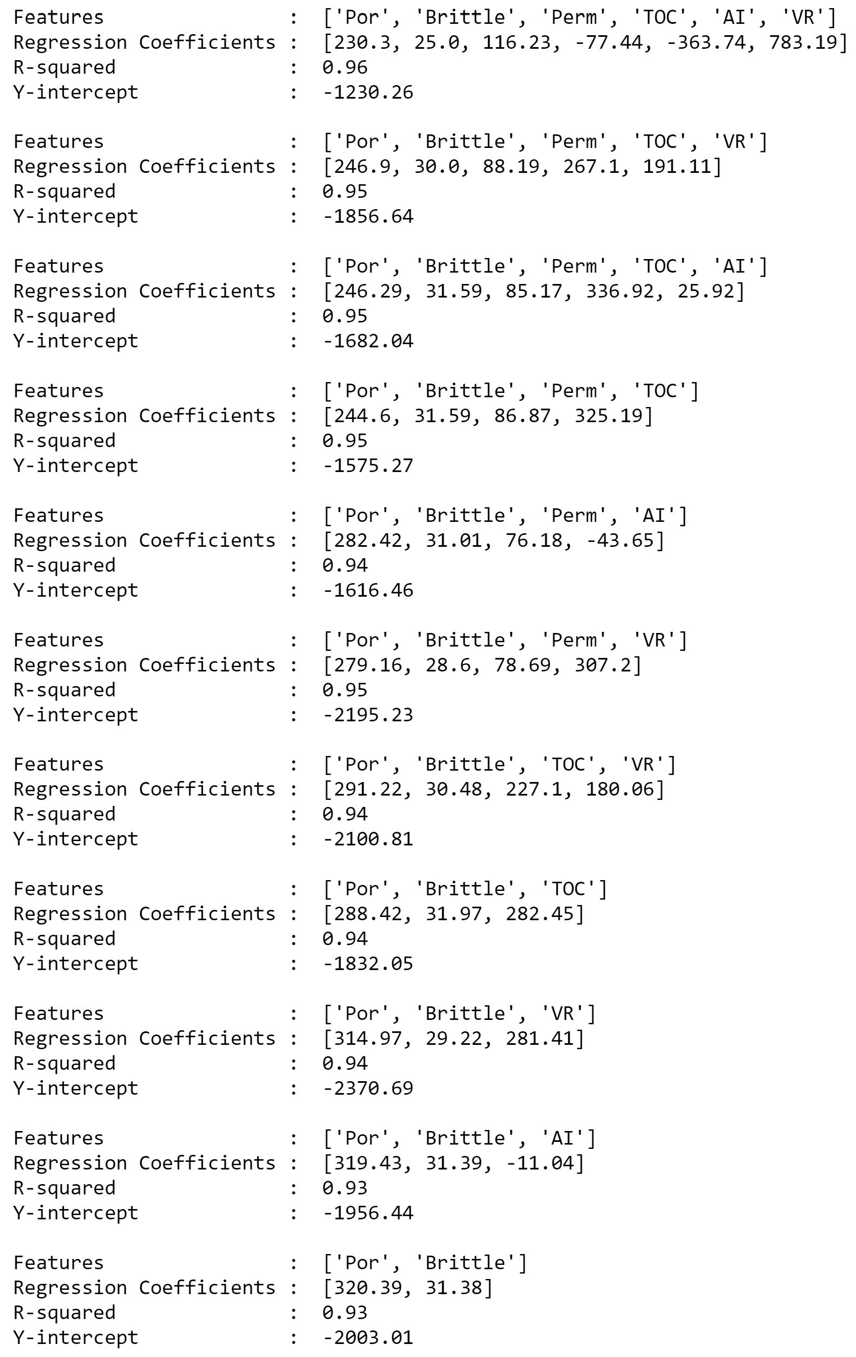
aegis4048.github.io
aegis4048.github.io
Unstable regression coefficient values for ‘Por’

Slide 15
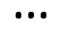
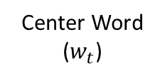
Feature vector
Center Word
($w_{t}$)
man passes sentence should swing sword the who
The
0 0 0 0 0 0 1 0
man
1 0 0 0 0 0 0 0
who
0 0 0 0 0 0 0 1
aegis4048.github.io
sword
0 0 0 0 0 1 0 0

Slide 16
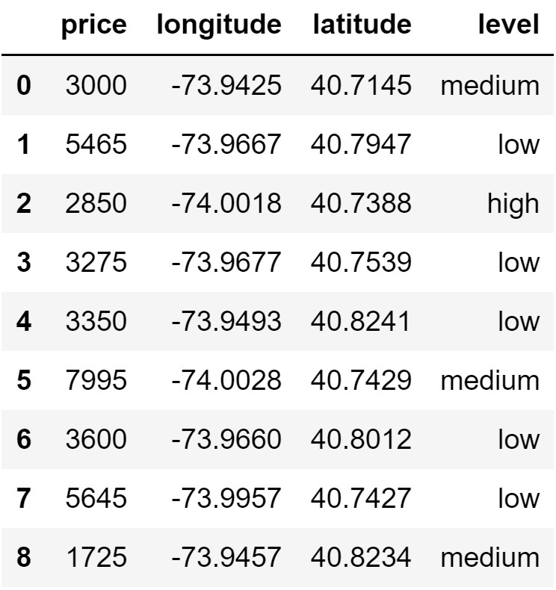
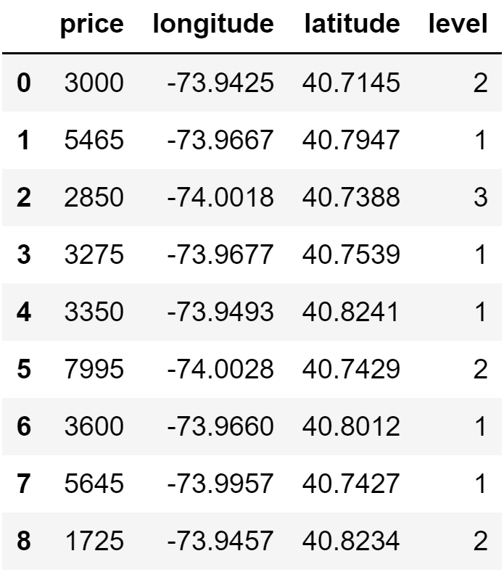
aegis4048.github.io
aegis4048.github.io

Slide 17
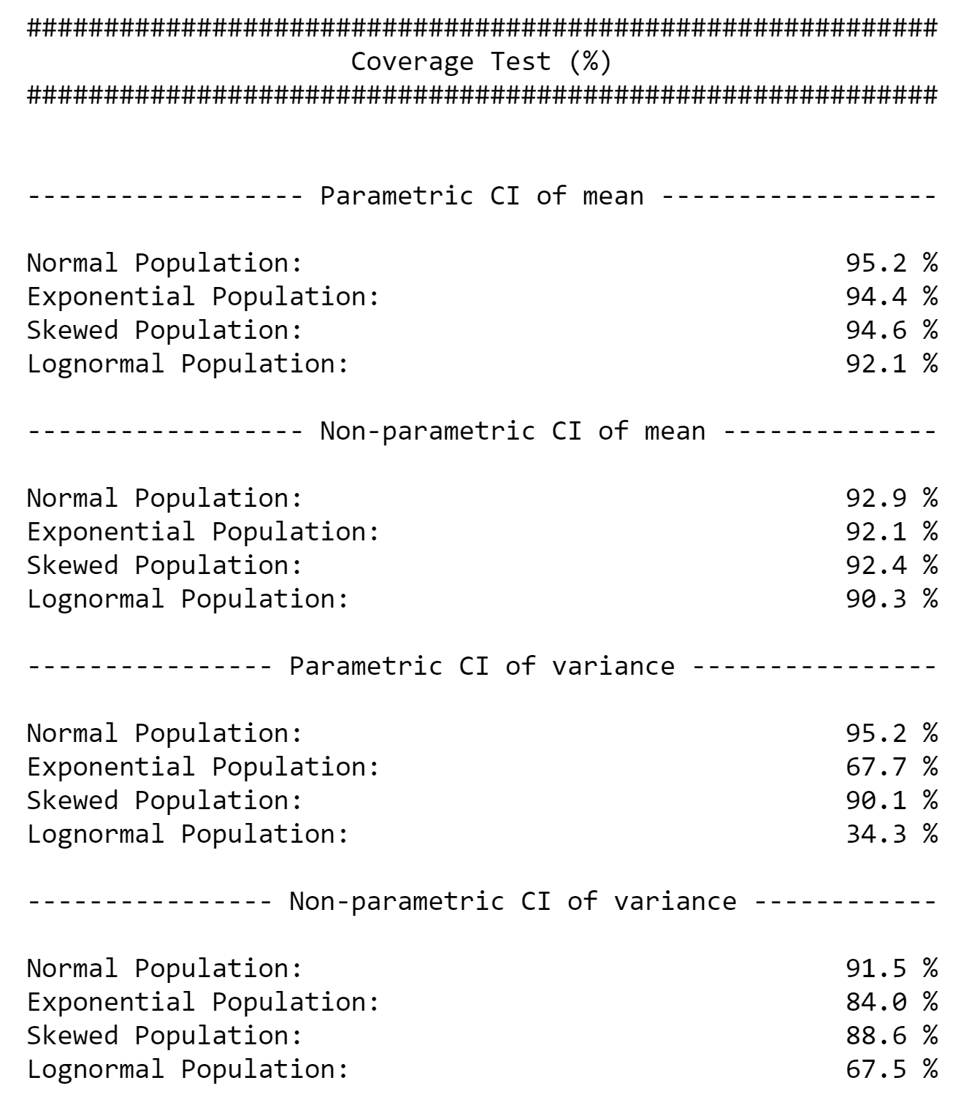
aegis4048.github.io

Slide 18
Direct Sampling
Bootstrap Resampling
VS.
5
7
8
5
12
17
8
11
13
6
4
15
6
2
3
4
10
2
9
14
1
16
Bootstrap population = Original sample
Population
aegis4048.github.io
6
5
5
6
6
5
4
2
4
2
6
8
5
4
8
8
2
8
8
2
5
5
4
4
2
8
6
6
2
Bootstrap
sample (n=5)
Bootstrap
sample (n=5)
Bootstrap
sample (n=5)
Bootstrap
sample (n=5)
Bootstrap
sample (n=5)
4
Mean = 5.2
Mean = 4.2
Mean = 5.2
Mean = 5.0
Mean = 5.4
Original sample
Bootstrap Samples
ANALYSIS
ANALYSIS

Slide 19
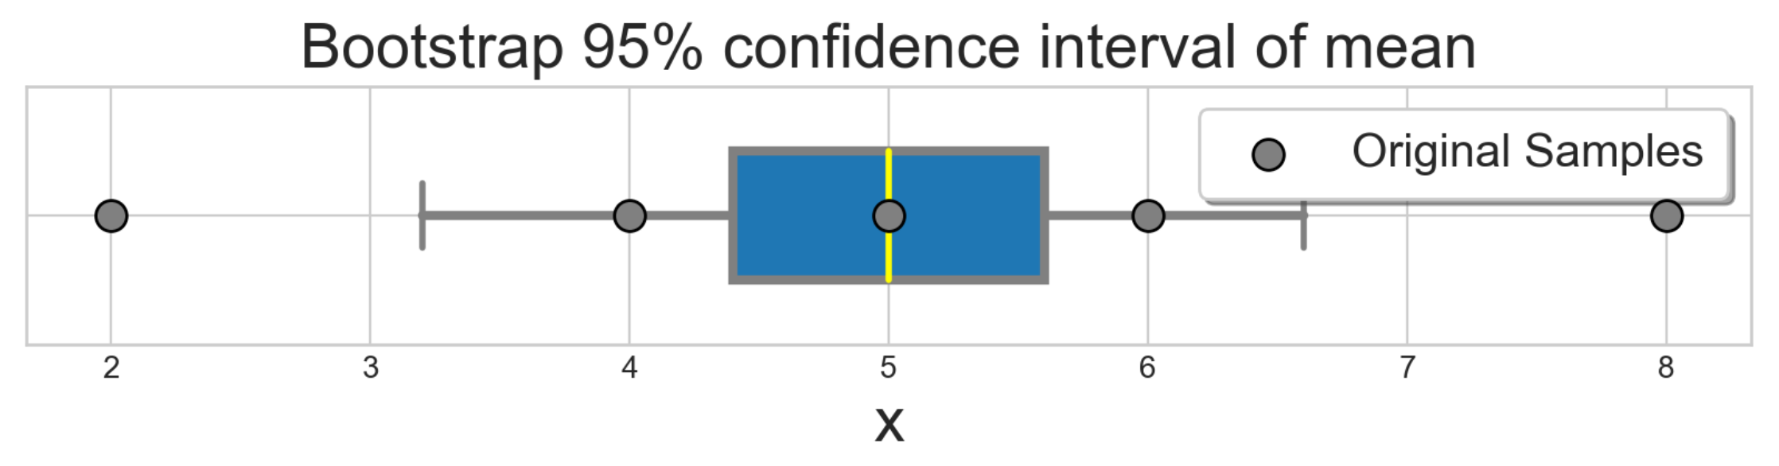


8
5
Original sample (n=5)
6
2
4
Monte-Carlo iteration of bootstrap $r=6$ times
aegis4048.github.io
6
6
6
5
8
5
5
8
4
6
2
4
2
8
6
4
8
8
2
8
5
2
5
4
4
2
8
6
8
2
Bootstrap
sample (n=5)
Bootstrap
sample (n=5)
Bootstrap
sample (n=5)
Bootstrap
sample (n=5)
Bootstrap
sample (n=5)
Bootstrap
sample (n=5)
Mean = 5.2
Mean = 4.2
Mean = 5.2
Mean = 5.0
Mean = 5.4
Mean = 6.4
aegis4048.github.io
$r=6$ bootstrap sample means

Slide 20
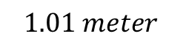
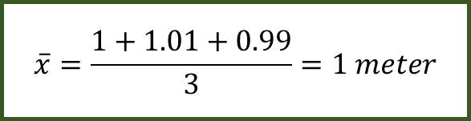
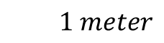
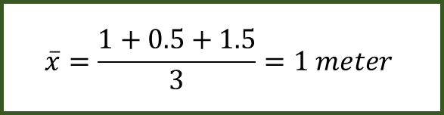
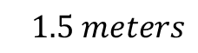
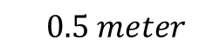


$$1 meter$$
$$\overline{x}=\frac{1+0.5+1.5}{3}=1 meter$$
$$0.5 meter$$
$$1.5 meters$$
aegis4048.github.io
$$1 meter$$
$$\overline{x}=\frac{1+1.01+0.99}{3}=1 meter$$
$$1.01 meter$$
$$0.99 meters$$
aegis4048.github.io

Slide 21
Mode 1
Mode 2
Median 1
Median 2
Mean 1
Mean 2
Overlap of 95% Conf. Int. of Means
aegis4048.github.io

Slide 22
Mean
Median
Fig (a)
Fig (b)
Mode
Mode
Median
Mean
95% Conf. Int. of Mean
95% Conf. Int. of Mean
aegis4048.github.io
aegis4048.github.io

Slide 23





95% chance that difference in mean
falls between -1.31 and 3.31
Lower Limit
Lower Limit
-1.31
3.31
95% Conf. Int. of Difference in Mean
$$1.00 ±2.31$$
$$H_{0}: μ_{1}−μ_{2}=0$$
$$0.00$$
aegis4048.github.io
$$H_{1}: μ_{1}−μ_{2}≠0$$
$$H_{1}: μ_{1}−μ_{2}≠0$$
$$μ_{1}−μ_{2}$$
$$1.00$$
2.5%
outliers
2.5%
outliers

Slide 24




Similar “enough”
“Significantly” different
aegis4048.github.io
aegis4048.github.io
$$μ_{1}$$
$$μ_{2}$$
$$μ_{1}$$
$$μ_{2}$$

Slide 25




























Population
Samples
aegis4048.github.io
sample set 1
aegis4048.github.io
aegis4048.github.io
sample set 2

Slide 26


Depends on type of distribution. Tells how many standard deviation away is the limit from the center
point estimate $±$ (dist.score $×$ SE)
= 12.32 $±$ (1.96 $×$ 1.816)
= 12.32 $±$ 3.56
Depends on type of statistic you want to compute.
For sample mean ($\overline{x}$): ${SE}_{\overline{x}}=s/{\sqrt{N}}$
For sample proportion ($p$): ${SE}_{p}=\sqrt{{p(1−p)}/N}$

Slide 27



Distribution of Population
falls between 4.70 and 24.42
Lower Limit
Lower Limit
4.70
24.42
95% Conf. Int. of Mean
$$12.32 ±3.56$$
$$8.76 \sim 15.88$$
Population Mean (unknown)
$$14.56$$
Sample Mean
$$12.32$$
aegis4048.github.io

Slide 28














Lower Limit
95% chance that population mean
falls between 8.76 and 15.88
Upper Limit
8.76
15.88
95% Conf. Int. of Mean $=12.32 ±3.56$
$$−3.56$$
$$+3.56$$
$$−(dist.score×SE)$$
$$+(dist.score×SE)$$
aegis4048.github.io
3.56 = distribution score $×$ Standard Error
2.5%
outliers
2.5%
outliers
Sample Mean = $12.32$
$$μ_{1}$$
$$μ_{2}$$
5% chance
$$μ_{3}$$
$$μ_{4}$$
$$μ_{5}$$
$$μ_{6}$$
$$μ_{7}$$

Slide 29


100% chance that your clip length
falls between 2cm and 3cm
2.?? cm
depends on tick mark spacing
1
2
3
4
5
6
7
8
point estimate $±$ measurement E.
2.5 $±$ 0.5 cm
cm
aegis4048.github.io

Slide 30

aegis4048.github.io
aegis4048.github.io

Slide 31


Slide 32

aegis4048.github.io
aegis4048.github.io

Slide 33

aegis4048.github.io
aegis4048.github.io

Slide 34

aegis4048.github.io
aegis4048.github.io

Slide 35

aegis4048.github.io
aegis4048.github.io

Slide 36

aegis4048.github.io
aegis4048.github.io

Slide 37

aegis4048.github.io
aegis4048.github.io

Slide 38

aegis4048.github.io
aegis4048.github.io

Slide 39

aegis4048.github.io
aegis4048.github.io

Slide 40

aegis4048.github.io
aegis4048.github.io

Slide 41

aegis4048.github.io
aegis4048.github.io

Slide 42

aegis4048.github.io

Slide 43

aegis4048.github.io

Slide 44


Binomial Classification
(regression, logistic)
(regression, zebra)
(regression, machine)
(regression, pimples)
(regression, sigmoid)
VS
(regression, Gangnam-Style)
(regression, supervised)
(regression, toothpaste)
aegis4048.github.io
(regression, neural)
(regression, idiot)
Likely to observe
$$p(D=1|w,c_{pos})≈1$$
Unlikely to observe
$$p(D=1|w,c_{neg})≈0$$

Slide 45



True: $σ\left(x\right)$ > 0.5
False: $σ\left(x\right)$ < 0.5
aegis4048.github.io

Slide 46

aegis4048.github.io
aegis4048.github.io

Slide 47










Center word: drilling
$$K=5$$
$$iter=1$$
$$iter=2$$
$$iter=3$$
$$iter=4$$
Current context word: engineer
$$p\left(D=1 | w_{drilling},c_{engineer}\right)$$
$$p(D=1|w_{drilling},c_{minimized})$$
$$p(D=1|w_{drilling},c_{primary})$$
$$p(D=1|w_{drilling},c_{concerns})$$
$$p(D=1|w_{drilling},c_{led})$$
$$p\left(D=1 | w_{drilling},c_{page}\right)$$
0.432
0.312
0.565
0.102
0.853
0.642
0.653
0.169
0.221
0.043
0.532
0.380
0.853
0.042
0.083
0.009
0.115
0.101
0.998
0.000
0.001
0.000
0.001
0.002
engineer
minimized
Update $θ$
Update $θ$
Update $θ$
primary
$$=$$
concerns
led
aegis4048.github.io
aegis4048.github.io
aegis4048.github.io
page

Slide 48
Drilling fluids serve to balance formation pressures while drilling to ensure wellbore stability. They also carry cuttings to the surface and cool the bit. The drilling engineer traditionally designs drilling fluids with two primary goals in mind:
To ensure safe, stable boreholes, which is accomplished by operating within an acceptable mud-weight window
To achieve high rates of penetration so that rig time and well cost can be minimized
These primary considerations do not include well productivity concerns. A growing recognition of the importance of drilling-induced formation damage has led to the use of drill-in fluids (fluids used to drill through the pay zone) that minimize formation damage. This page discusses the formation damage that may be associated with various types of drilling fluids.
current context word
aegis4048.github.io
aegis4048.github.io

Slide 49

Vanilla Skip-Gram
aegis4048.github.io
aegis4048.github.io
Negative Sampling
aegis4048.github.io
aegis4048.github.io

Slide 50




Complexity = $O\left(V+V\right)≈O\left(V\right)$
where $V$ is very large
Computed $V$ times
for all vocabs
aegis4048.github.io
$V$ computations are needed to get normalization factor

Slide 51

aegis4048.github.io

Slide 52


aegis4048.github.io
aegis4048.github.io

Slide 53


aegis4048.github.io
aegis4048.github.io
aegis4048.github.io
aegis4048.github.io
aegis4048.github.io

Slide 54

aegis4048.github.io
aegis4048.github.io
aegis4048.github.io
aegis4048.github.io
aegis4048.github.io
aegis4048.github.io

Slide 55

aegis4048.github.io
aegis4048.github.io

Slide 56

aegis4048.github.io
aegis4048.github.io
aegis4048.github.io
aegis4048.github.io
aegis4048.github.io
aegis4048.github.io

Slide 57


aegis4048.github.io
aegis4048.github.io
aegis4048.github.io
aegis4048.github.io
aegis4048.github.io
aegis4048.github.io

Slide 58





$$iter=1$$
$$iter=2$$
$$iter=3$$
$$iter=4$$
0.24
0.42
0.20
0.12
-0.74
-0.82
0.18
0.30
0.12
0.09
-0.32
-0.46
0.08
0.12
0.04
0.02
-0.12
-0.13
0.01
0.02
0.01
0.00
-0.01
-0.02
man
$$\sum_{c=1}^{C}{e_{c}}=$$
passes
Update $θ$
Update $θ$
Update $θ$
sentence
should
aegis4048.github.io
aegis4048.github.io
the
who

Slide 59





$$c=1$$
$$c=2$$
0.12
0.21
0.10
0.06
-0.87
0.09
0.12
0.21
0.10
0.06
0.13
-0.91
0.24
0.42
0.20
0.12
-0.74
-0.82
man
passes
$$\sum_{c=1}^{C}{e_{c}}=$$
sentence
$$+$$
$$=$$
should
aegis4048.github.io
the
who

Slide 60






$$y_{true}$$
($V$-dim)
$$y_{pred}−y_{true}$$
($V$-dim)
0
0
0
0
1
0
0.12
0.21
0.10
0.06
-0.87
0.09
man
$$y_{pred}$$
($V$-dim)
passes
sentence
$$=$$
should
0.12
0.21
0.10
0.06
0.13
0.09
$$−$$
c = 1
the
who
aegis4048.github.io
0
0
0
0
0
1
0.12
0.21
0.10
0.06
0.13
-0.91
man
$$−$$
passes
sentence
$$=$$
should
c = 2
the
who

Slide 61
Dimension 3
0.11
0.34
0.54
Achieve
Achieve
Success
aegis4048.github.io
aegis4048.github.io
0.51
0.91
0.65
Success
Dimension 1
Vector distance
Dimension 2

Slide 62
Training Samples
Source Text
The
man
who
passes
the
sentence
should
swing
the
sword.
(passes, who)
(passes, the)

Slide 63
Dimension 3
should
passes
0.1 0.2 0.7
passes
aegis4048.github.io
should
-2 0.2 0.8
aegis4048.github.io
Dimension 1
Dimension 2

Slide 64





Makes it positive
$$W_{output}∙h$$
Softmax ($W_{output}∙h$)
$$y_{pred}$$
0.042 0.020
0.006
0.007
-0.005
0.030
0.052
-0.021
0.128
0.125
0.124
0.124
0.122
0.127
0.130
0.120
$$p\left(y_{i}\right)=\frac{e^{y_{i}^{}}}{\sum_{j}{e^{y_{j}}}}$$
aegis4048.github.io
Normalizes to range [0, 1]
Sum($y_{pred})$ = 1

Slide 65

$$W_{input}$$
($V×N$)
man
2 0.5 4
0.1 0.2 0.7
0.3 -2 0.2
-2 0.2 0.8
1 0.7 3
3 5 0.2
passes
sentence
should
aegis4048.github.io
the
who

Slide 66




$$y_{true}$$
($V$-dim)
$$y_{pred}−y_{true}$$
($V$-dim)
0
0
0
0
1
0
0.12
0.21
0.10
0.06
-0.87
0.09
man
$$x$$
($V$-dim)
$$W_{input}$$
($V×N$)
$$h$$
($N$-dim)
$$W_{output}^{T}$$
($N×V$)
$$y_{pred}$$
($V$-dim)
passes
sentence
$$=$$
should
man
0
1
0
0
0
0
2 0.5 4
0.1 0.2 0.7
0.3 -2 0.2
-2 0.2 0.8
1 0.7 3
3 5 0.2
0.12
0.21
0.10
0.06
0.13
0.09
$$−$$
c = 1
passes
the
sentence
0.1
0.2
0.7
0.3 0.1 0.4 -0.4
0.1 0.3 -1.1 0.3
0.1 0.2 0.4 0.1
who
should
aegis4048.github.io
aegis4048.github.io
0
0
0
0
0
1
0.12
0.21
0.10
0.06
0.13
-0.91
man
the
$$−$$
passes
who
sentence
$$=$$
should
c = 2
Input Layer one-hot encoded vector
Word-Embedding matrix – a.k.a “Lookup table”
Hidden (Projection)
Layer for center word (passes)
Word-Embedding matrix for context words (the, who)
Softmax Output
Layer of range
[0, 1)
Sum = 1
the
who
Prediction Error – a.k.a function loss

Slide 67





$$x$$
($V$-dim)
$$W_{input}$$
($V×N$)
$$h$$
($N$-dim)
man
0
1
0
0
0
0
2 0.5 4
0.1 0.2 0.7
0.3 -2 0.2
-2 0.2 0.8
1 0.7 3
3 5 0.2
passes
sentence
0.1
0.2
0.7
Projection of word vector for “passes” from the embedding matrix
should
$$×$$
$$=$$
aegis4048.github.io
the
who

Slide 68







Input Layer ($x$)
($V$-dim)
Assuming Stochastic Gradient Descent…
Center Word
($w_{t}$)
v=0
v=1
v=2
v=3
v=4
v=5
v=6
v=7
man passes sentence should swing sword the who
t=0
The
0 0 0 0 0 0 1 0
t=0
$$θ_{new}=θ_{old}−η∙∇_{θ}J_{0}(θ;w^{(0)})$$
t=1
man
1 0 0 0 0 0 0 0
$$θ_{new}=θ_{old}−η∙∇_{θ}J_{1}(θ;w^{(1)})$$
t=2
who
0 0 0 0 0 0 0 1
$$θ_{new}=θ_{old}−η∙∇_{θ}J_{2}(θ;w^{(2)})$$
aegis4048.github.io
aegis4048.github.io
t=9
sword
0 0 0 0 0 1 0 0
$$θ_{new}=θ_{old}−η∙∇_{θ}J_{9}(θ;w^{(9)})$$

Slide 69



Slide 70

killowatt
electricity
aegis4048.github.io
aegis4048.github.io
Oil Producers
Barrels + bpd

Slide 71

Oil Producers
Barrels + bpd
killowatt
electricity
aegis4048.github.io

Slide 72

electricity
killowatt
Barrels + bpd
Oil Producers
aegis4048.github.io

Slide 73
0
0
0.32
0.79
0
0.05
0.10
0
0
0.91
Achieve
aegis4048.github.io
aegis4048.github.io
0
0
0.34
0.75
0
0.10
0
0
0
0.87
Success

Slide 74
Dimension 3
0.11
0.34
0.54
Achieve
Achieve
Success
aegis4048.github.io
aegis4048.github.io
0.51
0.91
0.65
Success
Dimension 1
Dimension 2

Slide 75

aegis4048.github.io

Slide 76













2$m$
variance ($γ$)
sill ($σ^{2}$)
z($u_{α1}$)
z($u_{α1}+2m$)
2$m$
2$m$
2$m$
z($u_{α4}$)
z($u_{α4}+2m$)
nugget ($c_{0}$)
z($u_{α2}$)
z($u_{α2}+2m$)
2$m$
range ($a$)
range
z($u_{α3}$)
z($u_{α3}+2m$)
lag distance (h)

Slide 77









3$m$
variance ($γ$)
sill ($σ^{2}$)
z($u_{α1}$)
z($u_{α1}+3m$)
3$m$
3$m$
z($u_{α3}$)
z($u_{α3}+3m$)
nugget ($c_{0}$)
range ($a$)
3$m$
range
z($u_{α2}$)
z($u_{α2}+3m$)
lag distance (h)

Slide 78




variance ($γ$)
sill ($σ^{2}$)
nugget ($c_{0}$)
range ($a$)
lag distance (h)

Slide 79


z($u_{α}$)
h
z($u_{α}+h$)

Slide 80








h
z($u_{α1}$)
z($u_{α1}+h$)
h
h
z($u_{α2}$)
z($u_{α2}+h$)
z($u_{α1}$)
z($u_{α}+h$)
h
z($u_{α3}$)
z($u_{α3}+h$)

Slide 82
Y axis (North)
Lag Tolerance
Lag 3
Azimuth
Lag 2
Bandwidth
Lag 1
Azimuth Tolerance
X axis (East)

Slide 83

Z axis (vertical)
Horizontal Major
Horizontal Major
Azimuth
Horizontal Minor
Horizontal Minor
Horizontal Minor
$$θ$$
X axis (East)
Y axis (North)

Slide 84
Y axis (North)
Lag 3
Lag 2
Lag 1
X axis (East)

Slide 85

aegis4048.github.io
aegis4048.github.io
aegis4048.github.io
aegis4048.github.io

Slide 86

aegis4048.github.io

Slide 87

aegis4048.github.io

Slide 88

aegis4048.github.io

Slide 89

aegis4048.github.io

Slide 90

aegis4048.github.io
aegis4048.github.io

Slide 91

aegis4048.github.io

Slide 92

aegis4048.github.io

Slide 93


